Slide 1




VACCIBED
A Perfect health care
TEAM 28

Slide 2
Theme
Digitisation to ease access to social services

Slide 3
Problem Statement
The admission process in a hospital is cumbersome. Not all hospitals have the same facilities available to patients. Many who require immediate care lack the treatment because of not exactly knowing where and which hospital provides the required facility.

Slide 4
Introduction
The idea is to make a portal where people can take admission to nearby hospitals based on the facility or service they require. Certain cases need special care like contagious diseases like COVID. Also to incorporate vaccine availability in hospitals and booking slots for vaccinations. Rare vaccines like the ones for snake bites will be available only in a few hospitals. So in order to give immediate treatment after the bite, nearest and facilitated hospitals must be known to the people.

Slide 5
Methodology
Create a web app portal through which the individuals can book an appointment for beds or vaccines at hospitals according to availability.

Slide 6
MODULES
COVID BED PORTAL
Registration
Request Bed
Manage Bed
Allocate Hospital
Report

Slide 7
MODULES
Vaccine Portal
Registration
Request Vaccine
Manage Vaccine
Allocate Centre for Vaccination
Report

Slide 8
ACTORS and their roles
Covid Bed Portal
COVID Control Room Administrator
* Add new hospital
* Delete existing hospital
* Manage bed category
* Manage bed requests
* View patients

Slide 9
COVID bed portal
Hospital
*Manage bed requests
*Manage bed data
*Add patients
Patient
* Registration
* Request

Slide 10
Vaccine Portal
Control Room
* Add Different Vaccinations
* Add Vaccination Centres
* Manage Vaccination Requests

Slide 11
Vaccine Portal
Vaccination Centres
*Manage Vaccination
*Manage Patient
Patient
* Registration
* Request

Slide 12
Tech stack
Frontend
HTML ,JavaScript, CSS
Backend
PHP, MYSQL
IDE
Visual Studio Code

Slide 13
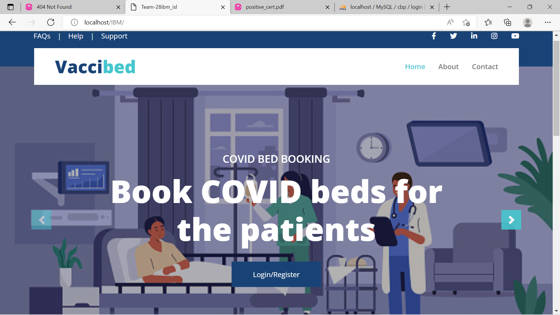
SCREENSHOTS

Slide 14
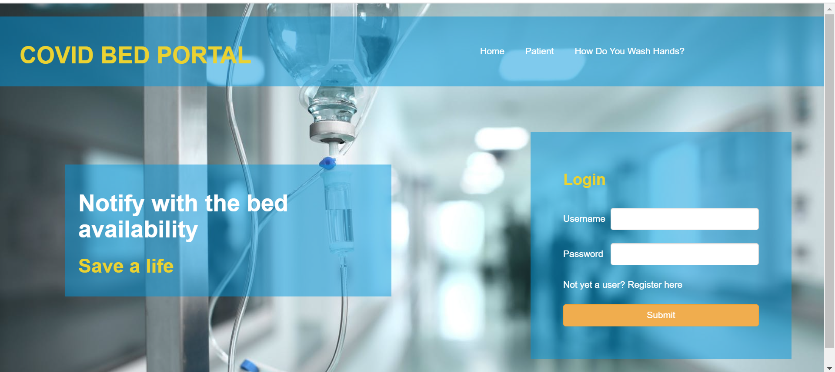
LOGIN for Covid bed portal

Slide 15
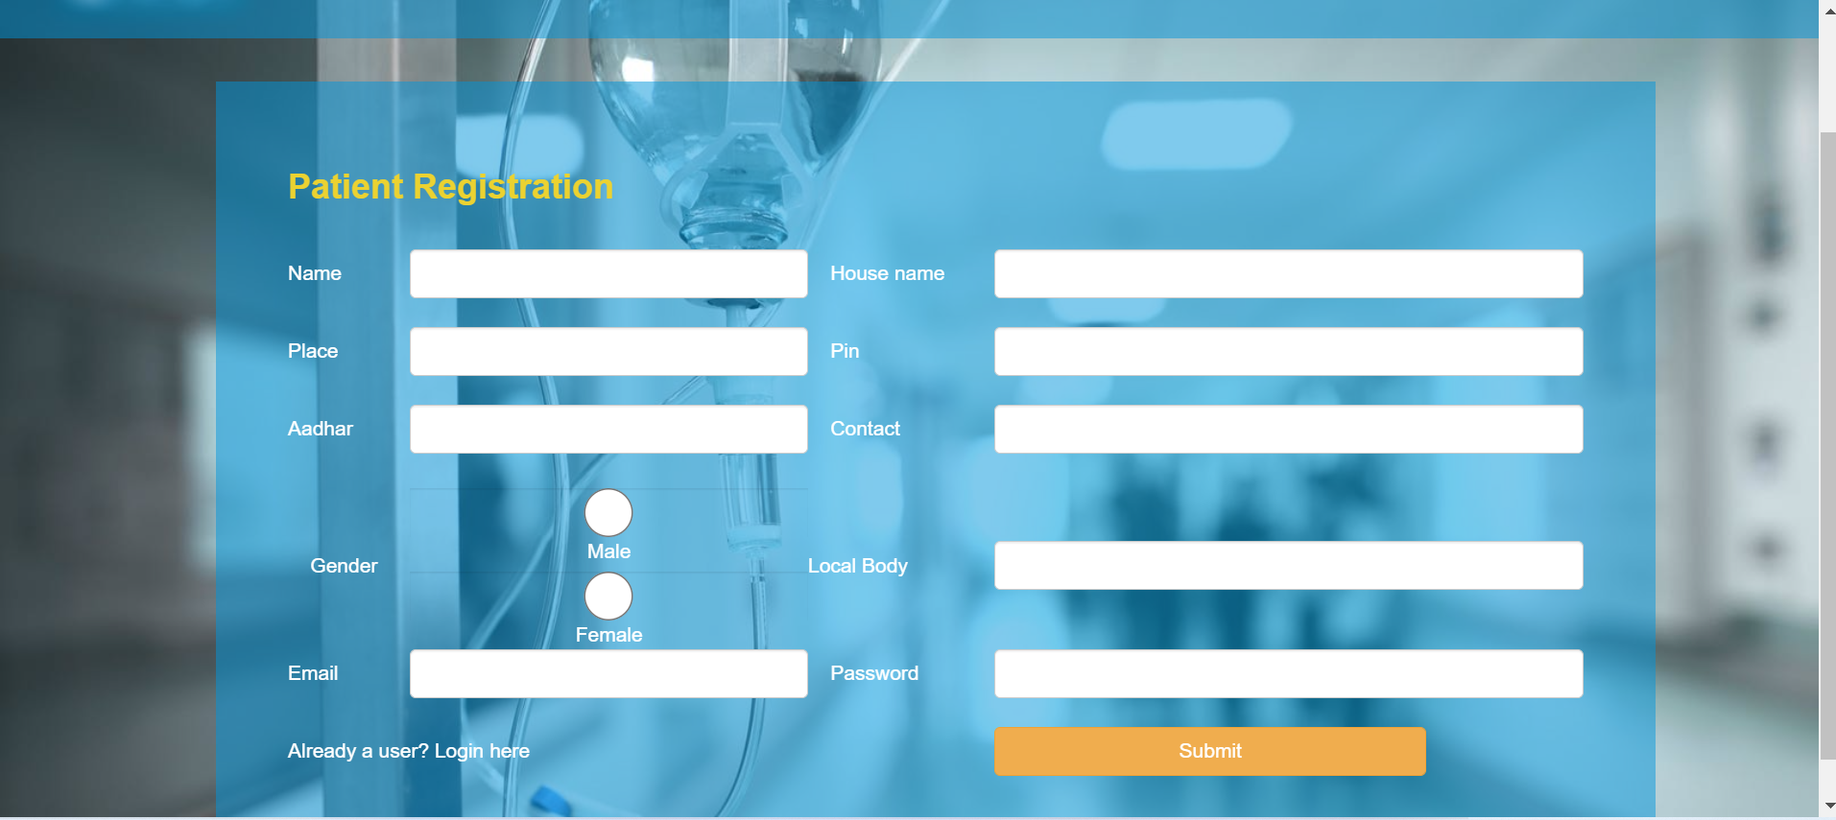
Patient registration

Slide 16
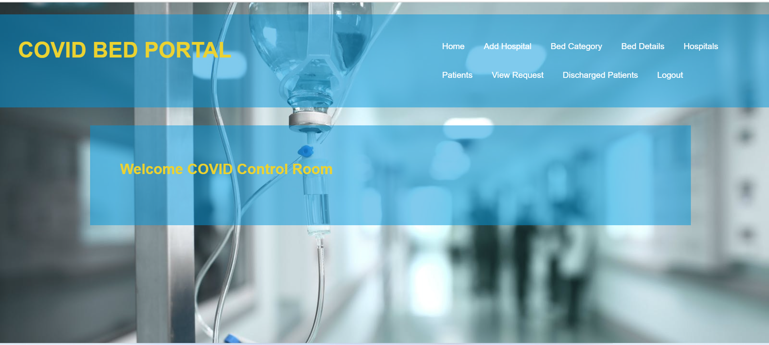
Admin dashboard

Slide 17
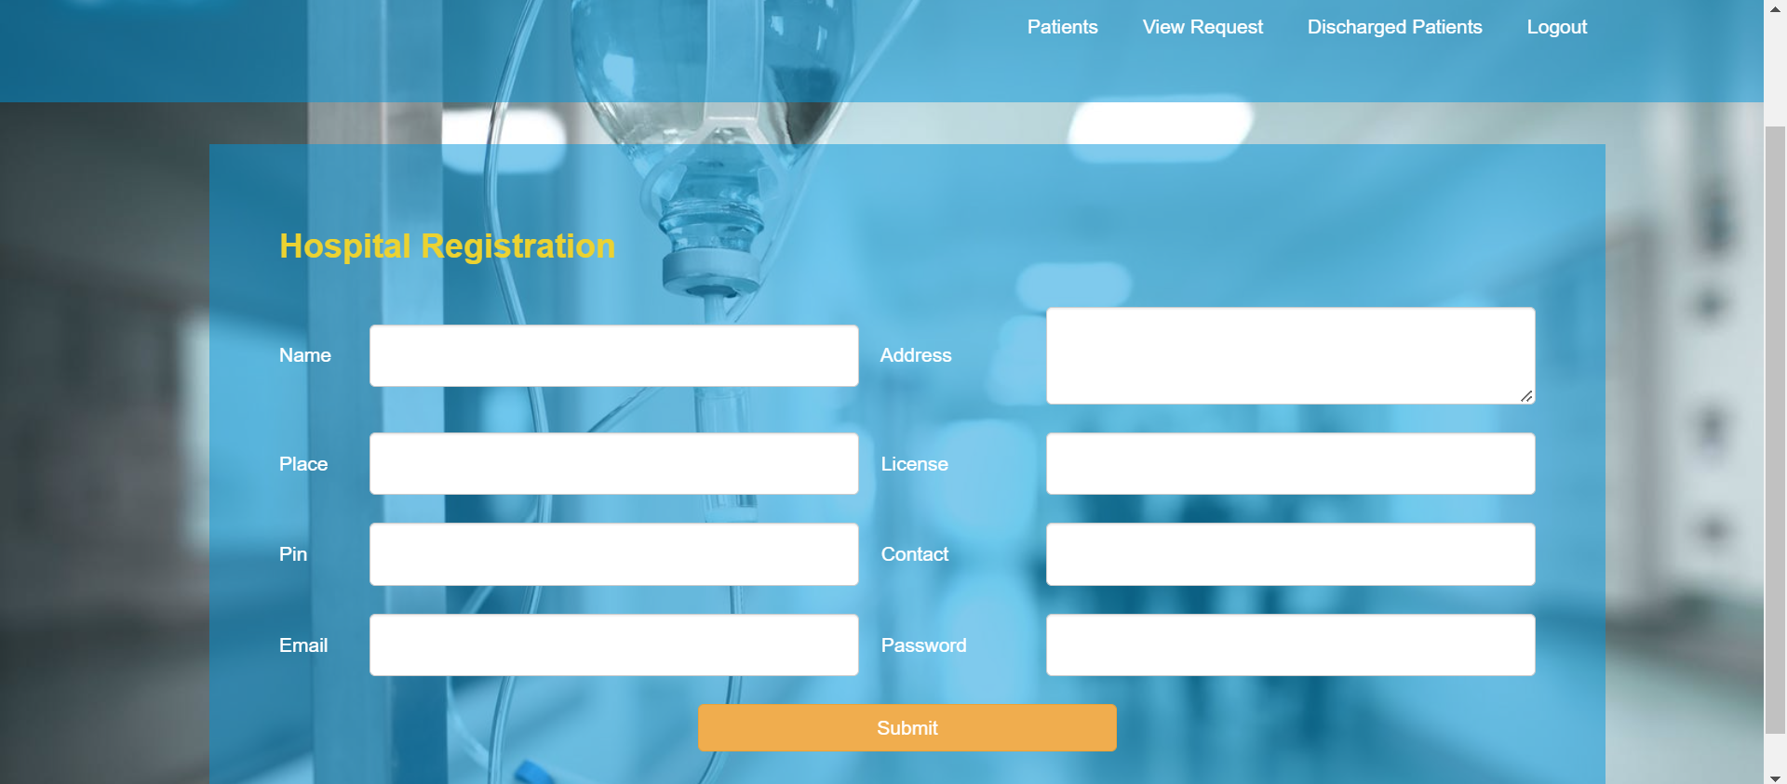
Adding hospital

Slide 18
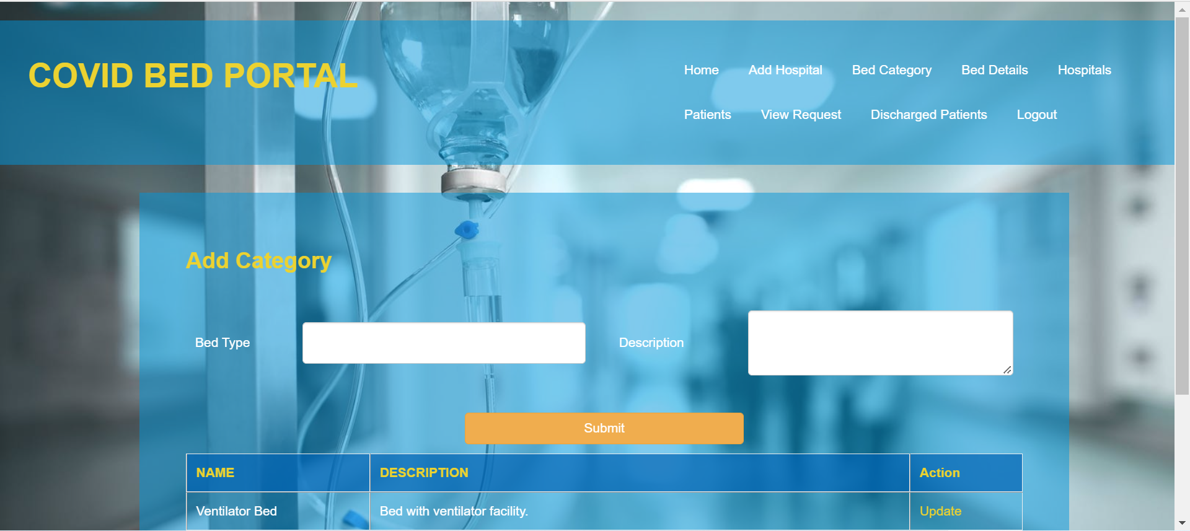
Adding bed category

Slide 19
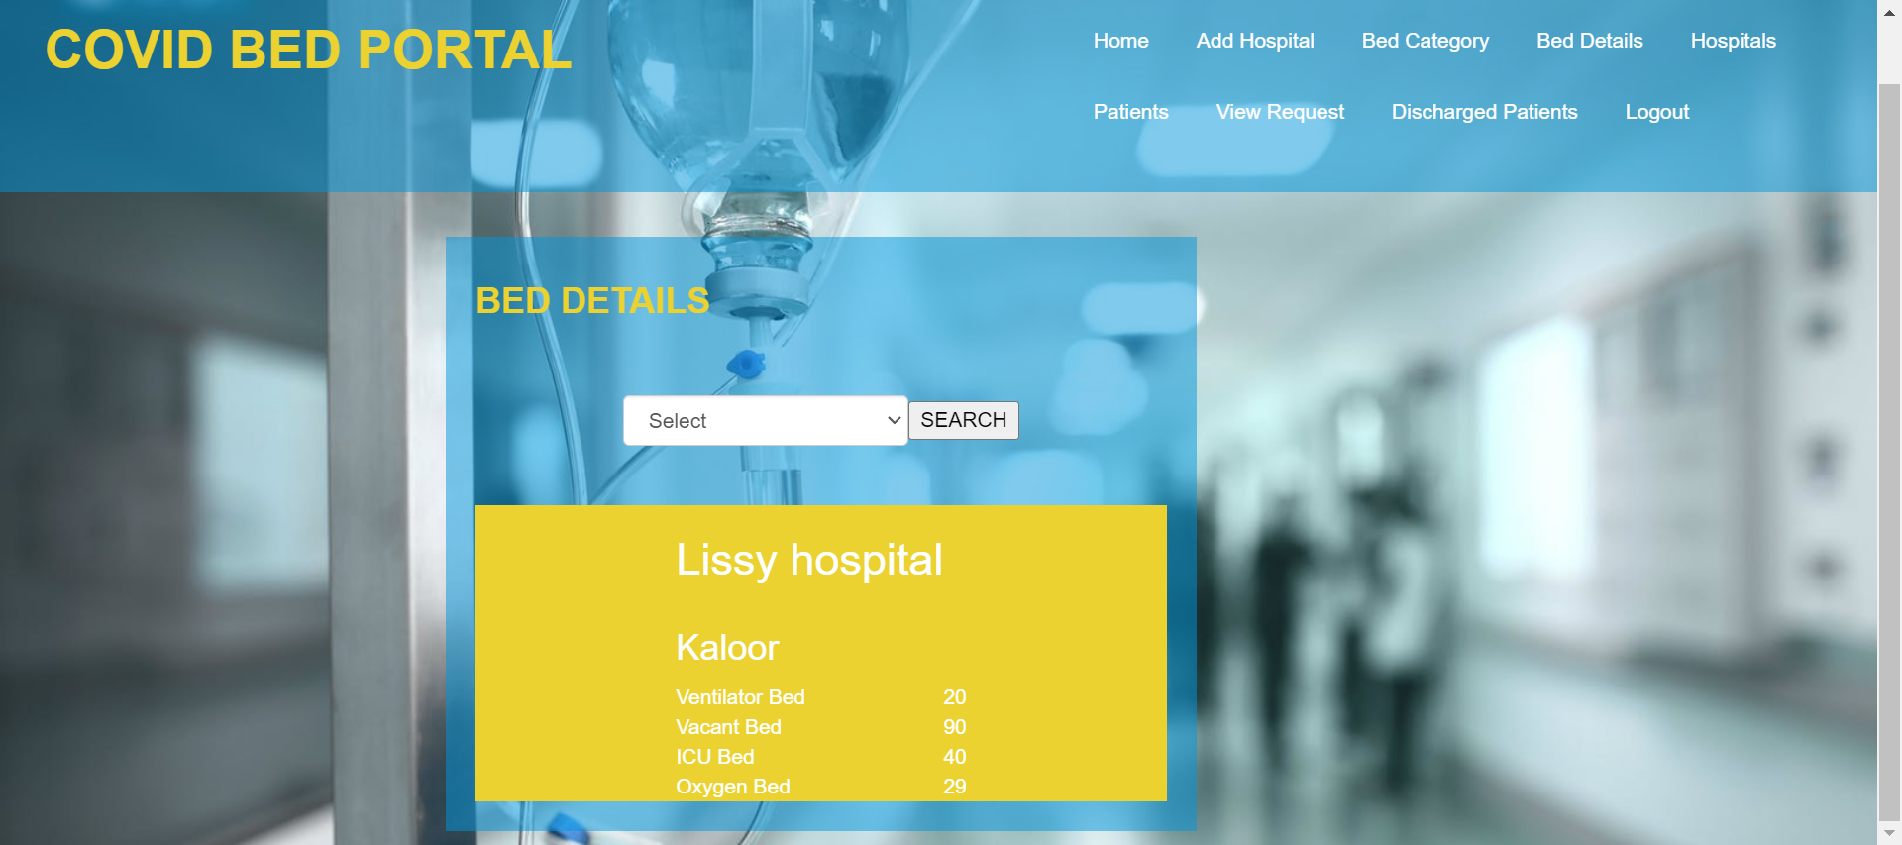
Viewing Bed Details

Slide 20
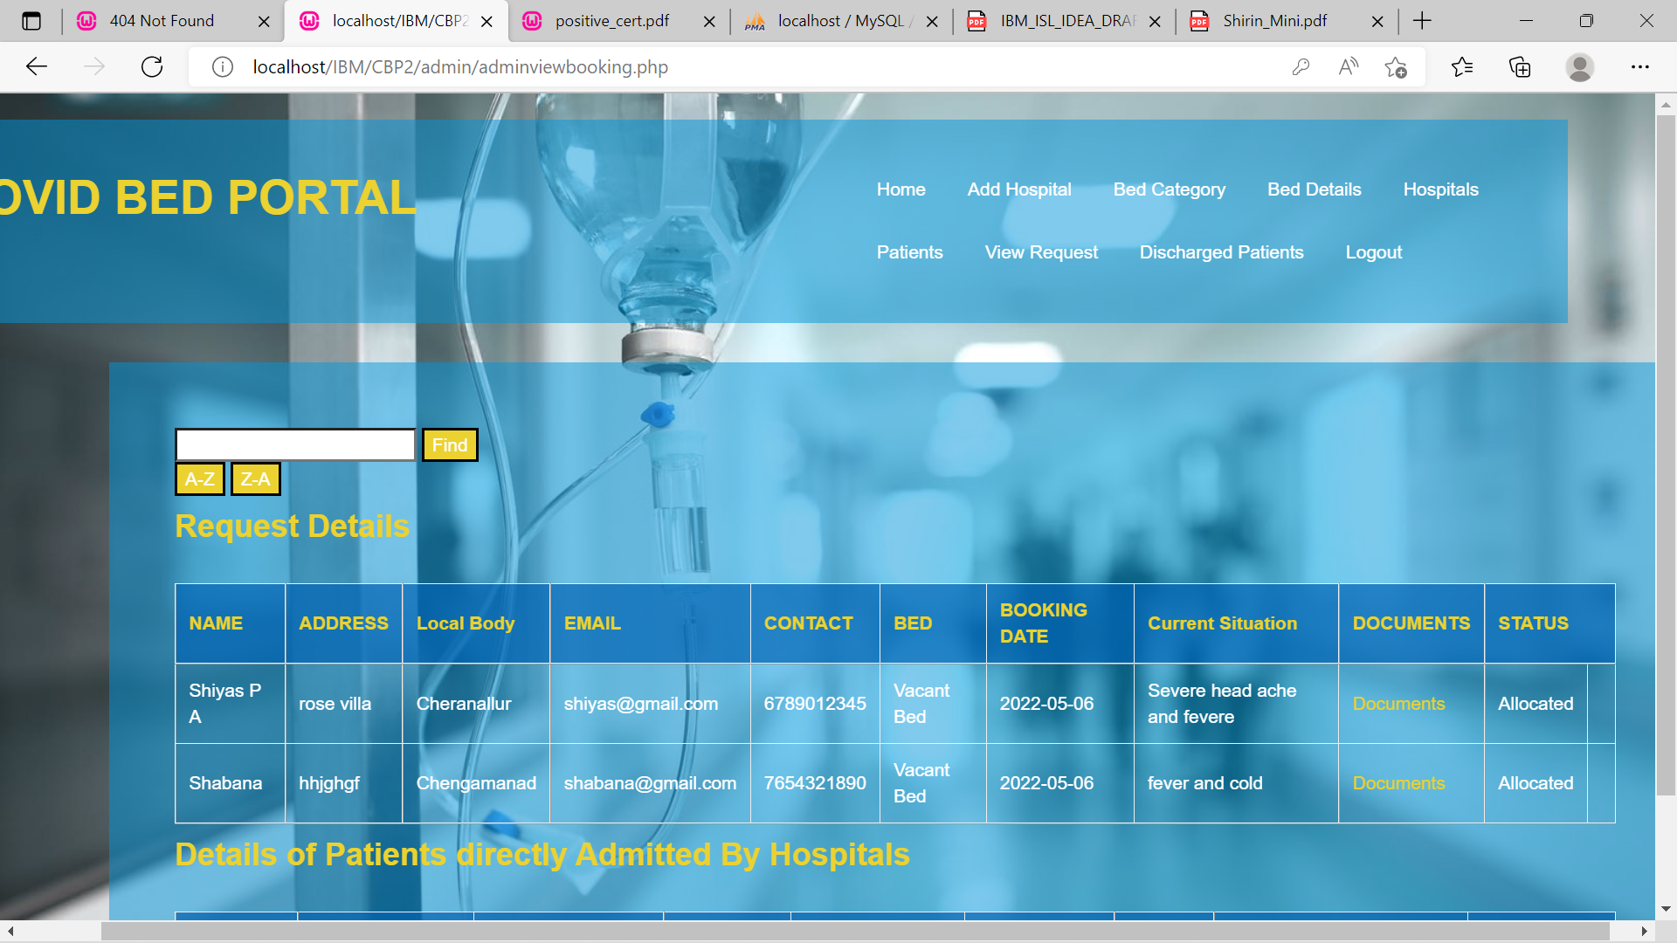
Managing patient requests (CONTROL ROOM)

Slide 21
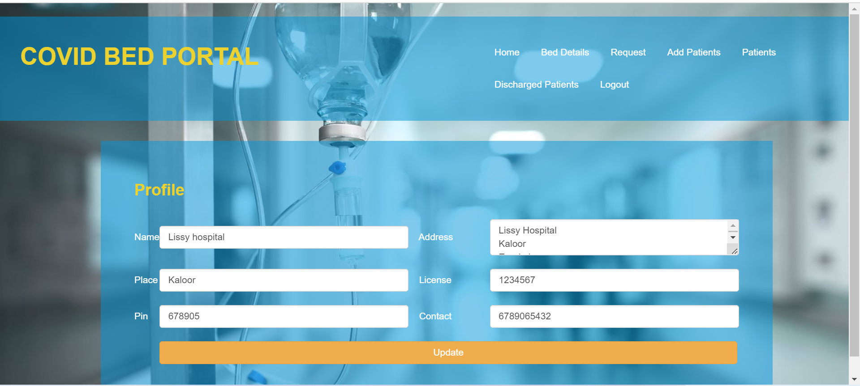
Hospital dashboard

Slide 22
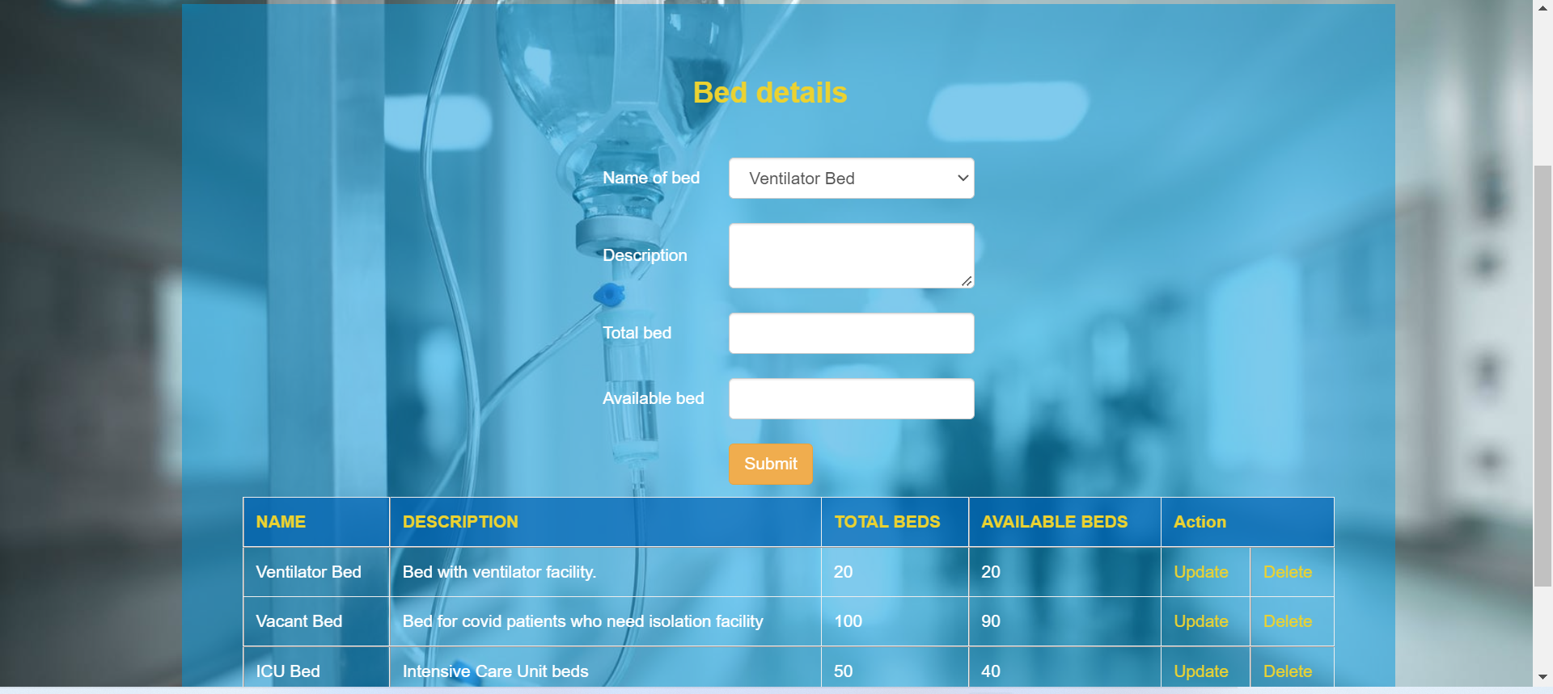
Adding bed details

Slide 23
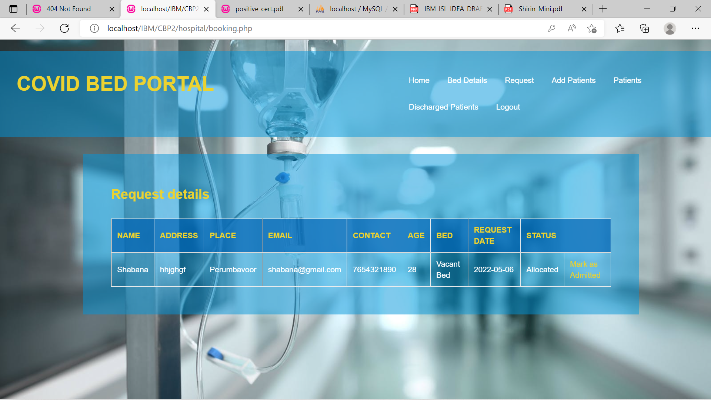
Request forwarded to the hospital

Slide 24
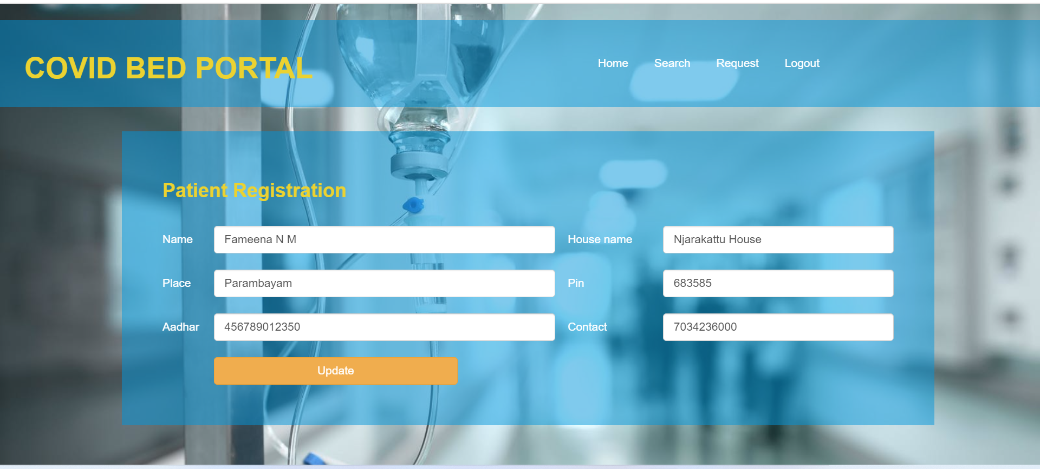
Patient Dashboard

Slide 25
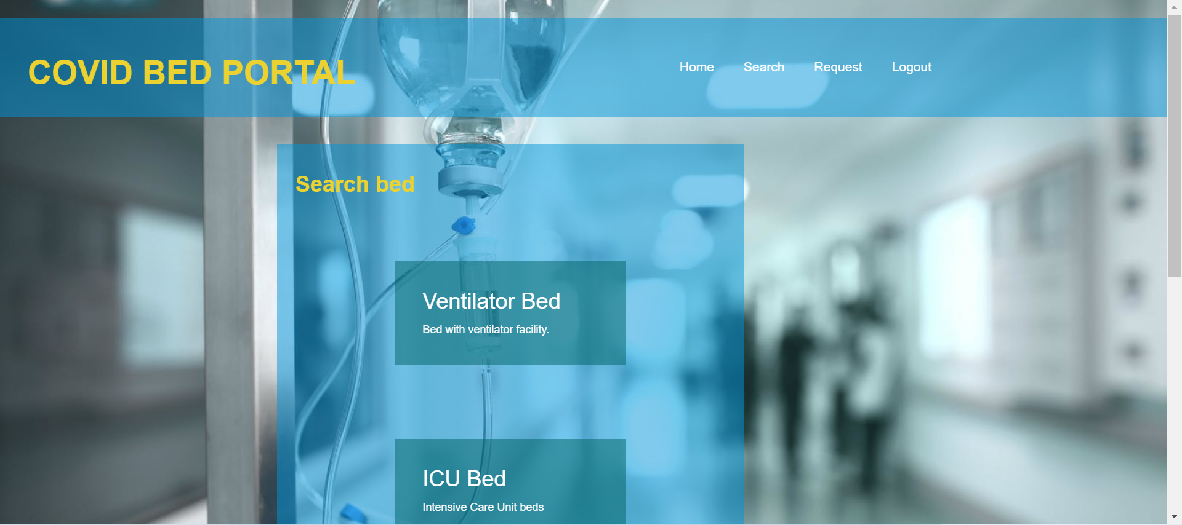
Requesting Bed

Slide 26
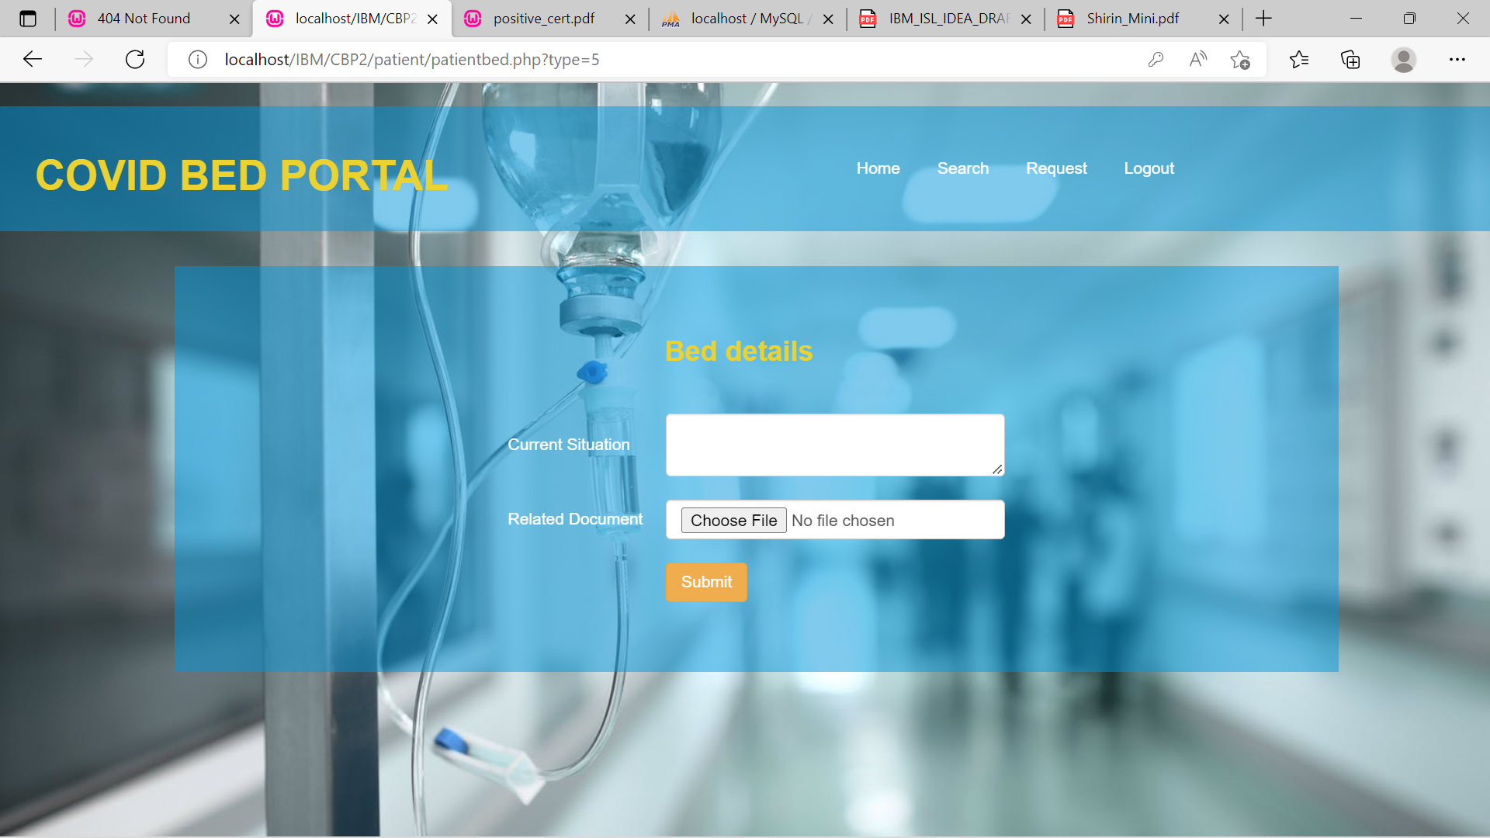
Bed request

Slide 27
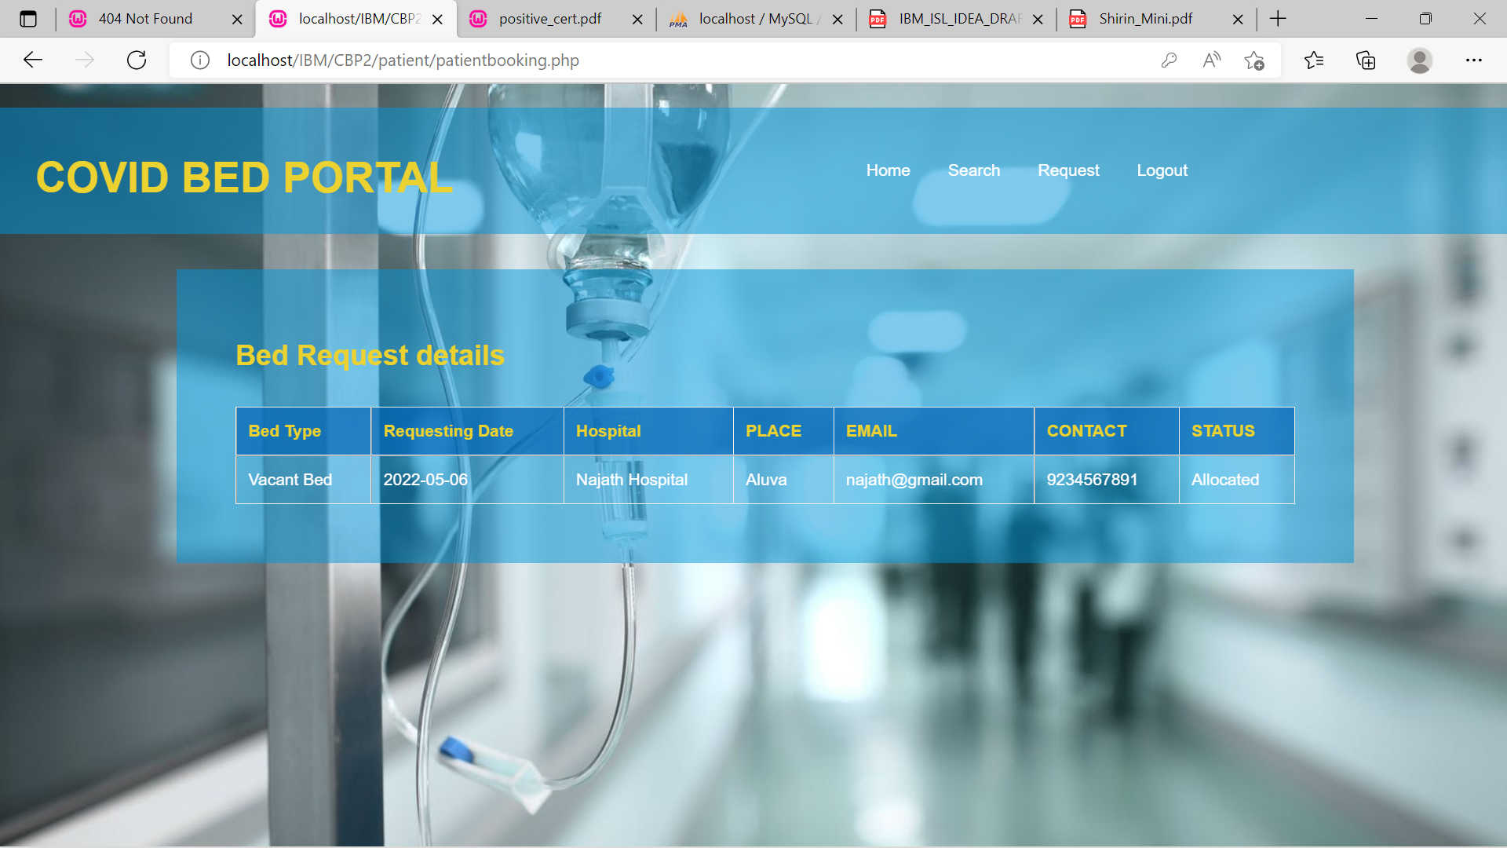
Status of request

Slide 28
THANK YOU

